Slide 1



AI for good 5g/ml challenge
Classification of Home Network Users to Improve Customer Experience

Slide 2





The Team: SPEARS-9
Hayden Myers
Kumar
Yash
Anuj Pratap Singh
Chhavi
Nijhawan
Sushma Reddy Mandhadapu

Slide 3


Table of Contents
Data Background
Indicator Importance
Future Scope
Conclusion
Business Recommendations
Data Cleaning and Outlier Detection
Problem Statement
Model Evaluation Summary
References & Appendix

Slide 4
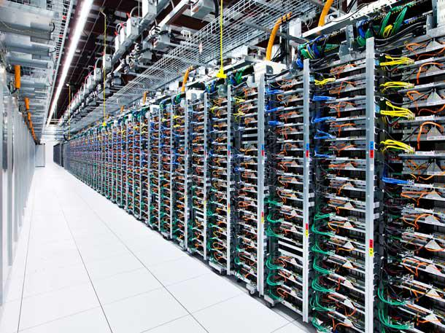
DATA
Users:
Good user count - 150
Bad user count – 150
Indicators:
Indicator 1 - Time interval between syn ack packet & ack packet in 3-way handshake.
Indicator 2 - Time interval between syn ack packet & ack packet in 2nd step.
Indicator 3 - Time interval between ack packet & 1st payload packet in 3-way handshake.
Indicator 4 - Response delay of 1st packet with payload after the establishment of TCP for multiple flows in the session.
Indicator 5 - Actual delay of transmission from the DPI position to the user terminal.
Indicator 6 - Transmission delay from the DPI position to the website.
Indicator 7 - Percentage of downlink retransmitted packets in the current session.
Indicator 8 - Percentage of upstream retransmission packets of the current session.

Slide 5
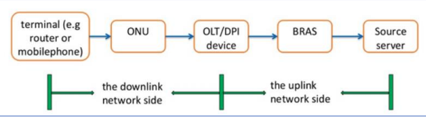
Problem statement
“Classification of Home Network Users to Improve User Experience”
DPI probe divides the broadband end-to-end network into 2 parts:
uplink network side.
downlink network side.
Downlink network side problems account for a large proportion of network problems.
Operators try to detect problems with the network's quality and improve the user’s experience as fast as possible.
Notes:
With the ever-changing and rapid growth of technology with mobile phones and the Internet, the home broadband system has become a key part of many people around the world’s day-to-day life. This increase has led to a progressively saturated market which is dependent upon the user's experience and the quality of broadband networks to determine whether the market is competitive with the users at hand. Many factors affect the user’s online experience. The DPI probe divides the broadband end-to-end network into two parts: the uplink network side and the downlink network side. The network layout is shown in the above figure. Downlink network side problems account for a large proportion of network problems. Many operators have turned their attention to detecting problems with the network's quality and improving the user’s experience as fast as possible. Accurately depicting whether a user is truly experiencing something classified as “good” or “bad” is a big concern for the operators in the future so they may be able to discover a complaint from the user before it ever happens.

Slide 6
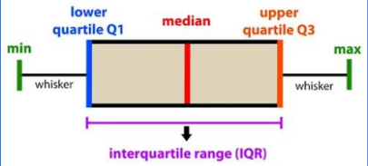
Data Cleaning & Outlier Detection
IQR Method:
Above box plot depicts current distribution of raw data. ‘Min’ and ‘Max’ in box plot show the dataset’s minimum and maximum values.
Range - The difference between the maximum and minimum.
Q4 – 4th percentile, which means 4% of the data lies between the minimum and Q1.
Q3 – 96th percentile, representing 96% of the data between minimum and Q3.
Min/ Max Scaling:
Scalar takes each value and subtracts the minimum, and then divides by the range.
Resultant values range between 0 and 1.
This reduces the standard deviation to minimize the effect of outliers on the model’s performance.

Slide 7
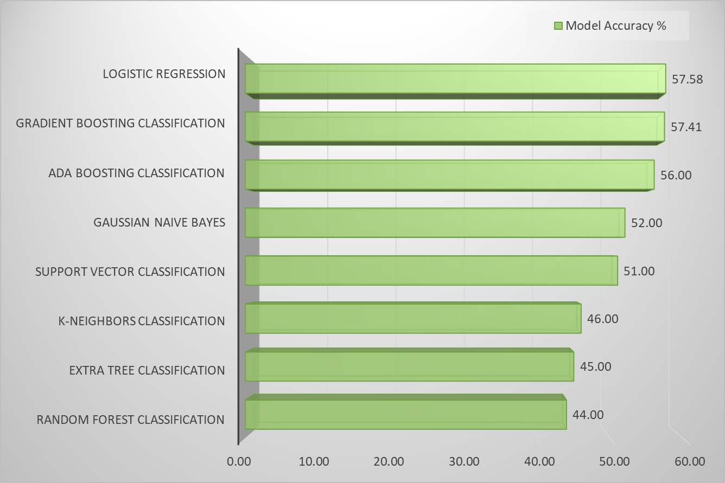
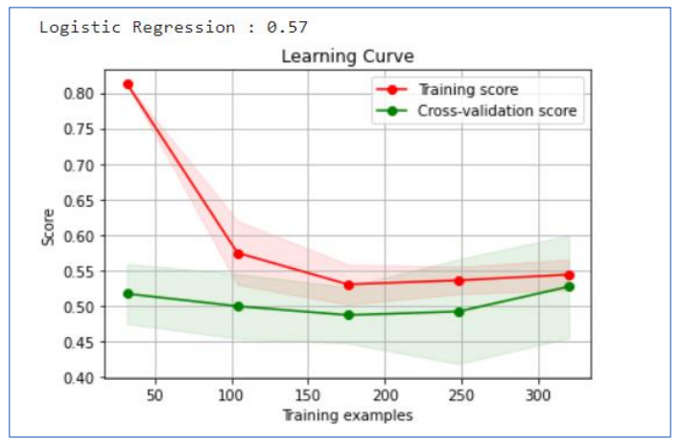
model evaluation Summary
Logistic Regression leads as the best performing model.
The green trend line depicts how the logistic regression model performed for the unseen dataset.

Slide 8

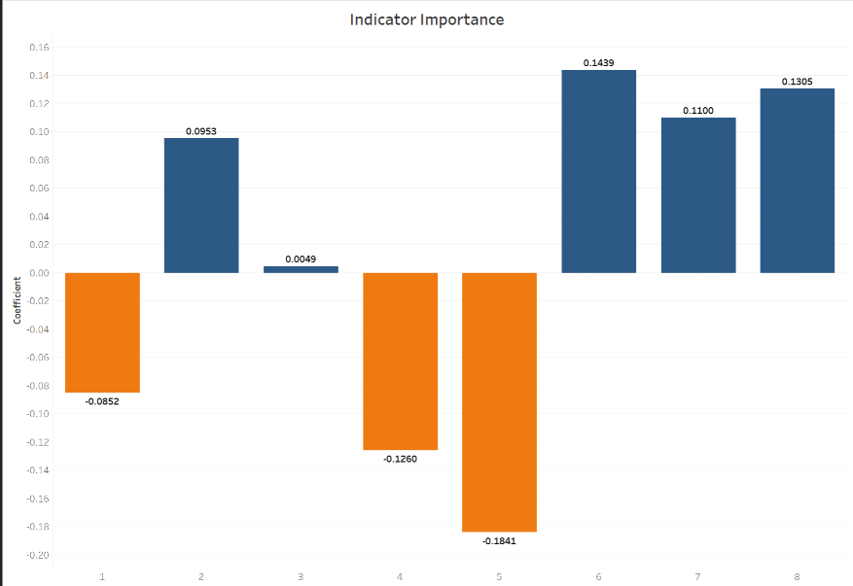
Indicator Importance
Based on the coefficients we observe that indicators 2, 6, 7, and 8 are more important indicators than 1, 4, and 5 for the logistic regression model.

Slide 9
Business recommendations
Anticipating customer needs and preparing operations to meet them.
Handling issues before customers face them.
Providing assurance to customers that they can get help whenever they need it.
Harness customer data to reduce the churn.
Faster resolution of customer issues.

Slide 10
Future scope
Get more data on the customer's location as well as pricing options they may have
Be provided with more detailed information about the indicators
Using the above mentioned, we could use these things to help understand more about the user experience in places with aa high population density, or if a customer is purchasing an average network plan rather than one that is faster but more expensive.
Overall, if we knew more about the domain and had some other data, it could allow us to make better recommendations for future use cases

Slide 11

References
https://towardsdatascience.com/why-1-5-in-iqr-method-of-outlier-detection5d07fdc82097
https://www.ibm.com/topics/logistic-regression
https://www.saedsayad.com/decision_tree.htm#:~:text=Decision%20tree%20builds%20c lassification%20or,decision%20nodes%20and%20leaf%20nodes
https://www.analyticsvidhya.com/blog/2021/06/understanding-random-forest/
https://monkeylearn.com/blog/introduction-to-support-vector-machines-svm/
• https://www.analyticsvidhya.com/blog/2021/09/adaboost-algorithm-a-complete-guidefor- beginners/
https://www.geeksforgeeks.org/ml-extra-tree-classifier-for-feature-selection/
Albashish D, Al-Sayyed R, Abdullah A, et al. Deep CNN Model based on VGG16 for Breast Cancer Classification[C]// 2021 International Conference on Information Technology (ICIT). 2021.

Slide 12
Thank You!
You can reach us at:
hmmyers@okstate.edu
kumar.yash@okstate.edu
anuj.singh@okstate.edu
chhavi.nijhawan@okstate.edu
sushma_reddy.mandhadapu@okstate.edu

Slide 13
Appendix

Slide 14
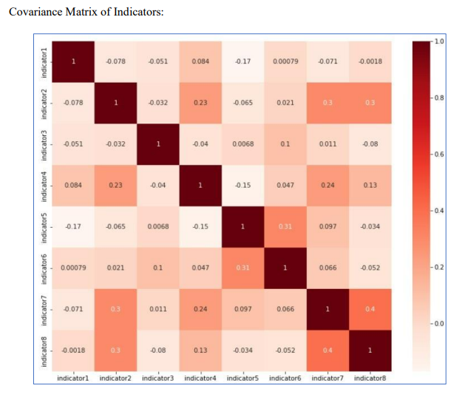
Covariance matrix
None of the indicators were highly correlated

Slide 15
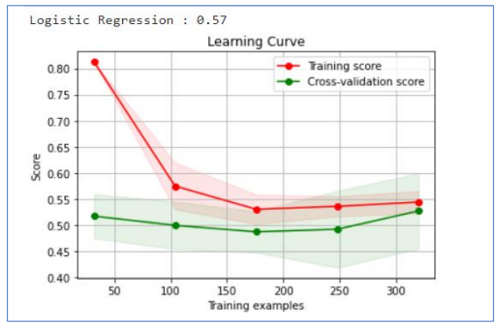
LOGISTIC REGRESSION
Based on a given dataset of independent variables, logistic regression calculates the likelihood that an event will occur.
This model has mathematical assumptions that would not be as accurate as a Neural Network, but we can easily depict variables that are driving the odds.
Accuracy: 57%

Slide 16
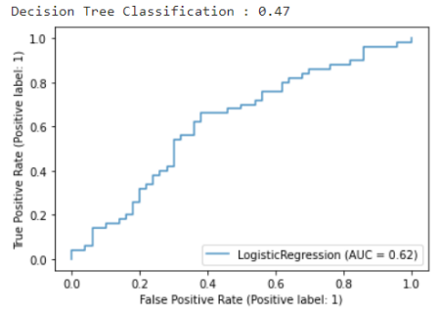
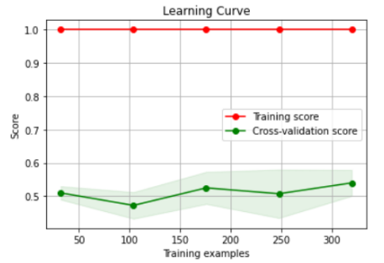
DECISION TREE classification
This model incrementally develops an associated rules while segmenting a dataset into smaller and smaller sections. The outcome is a tree containing leaf nodes and decision nodes.
Accuracy: 47%

Slide 17
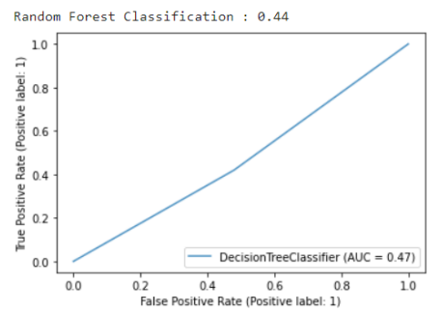
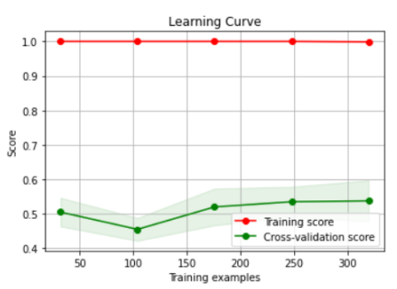
RANDOM FOREST classification
It constructs decision trees and uses their average for classification and majority vote for regression.
Accuracy: 44%

Slide 18
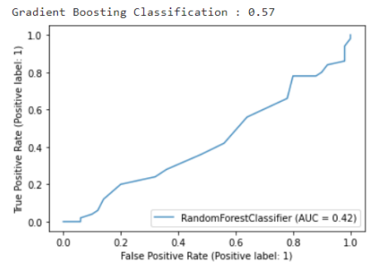
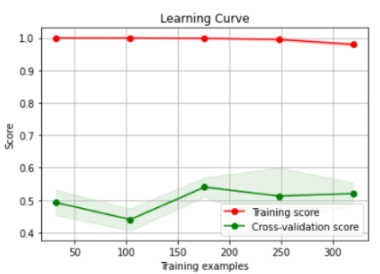
gradient boosting classification
Gradient boosting is one of the variants of ensemble methods where you create multiple weak models and combine them to get better performance.
Accuracy: 57%

Slide 19
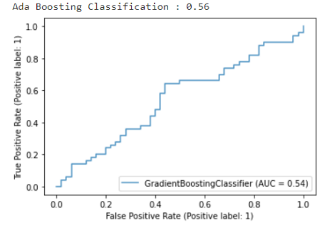
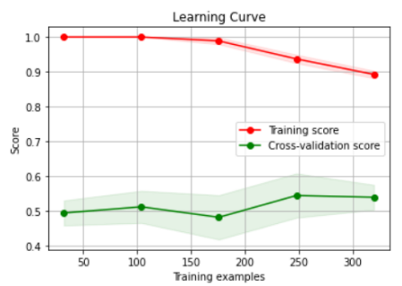
Ada boosting classification
This algorithm constructs a model and assigns equal weights to all data points. It then assigns higher weights to incorrectly classified points. It will continue to train models until a lower error is received.​
Accuracy: 56%​

Slide 20
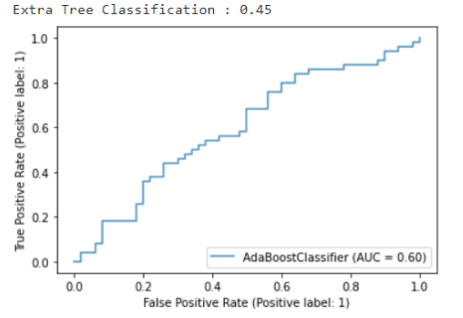
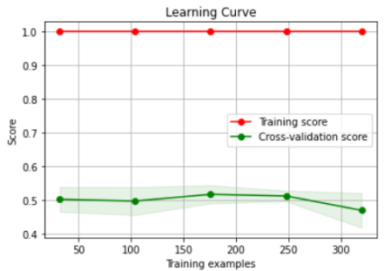
Extra tree classification
At each test node, each tree is given a random sample of k features from the feature set. This random selection of features results forming an ensemble model from de-correlated decision trees.
The evaluated model accuracy for the Extra Tree model is at 45%

Slide 21
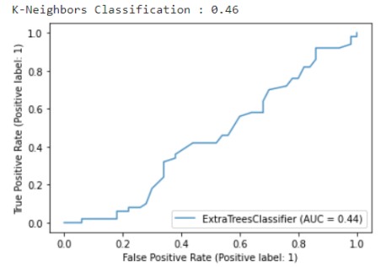
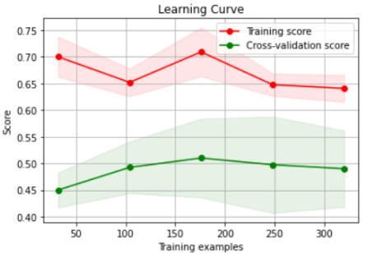
K-Neighbors CLASSIFICATION
KNN chooses the K examples closest to the query, and then, in the case of classification, votes for the label with the highest frequency or averages the labels.
The evaluated model accuracy for the K-Nearest Neighbors model is at 46%.

Slide 22
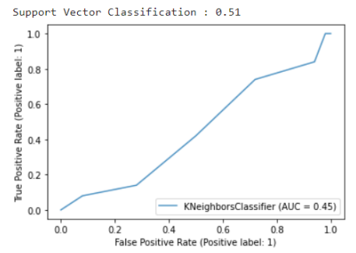
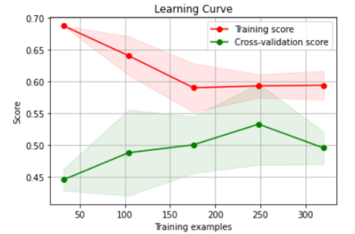
SUPPORT VECTOR CLASSIFICATION
An SVM model can classify new text after being given sets of labeled training data for each category. They offer two key advantages over more recent algorithms like neural networks: greater speed and improved performance.
The evaluated model accuracy for the Support Vector model is at 51%

Slide 23
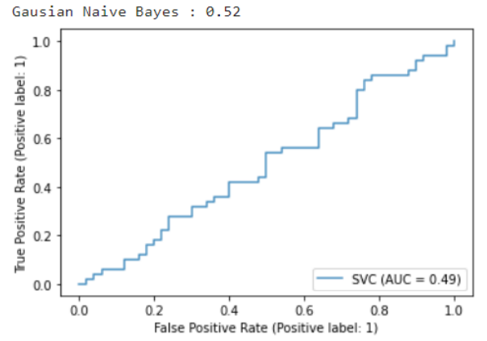
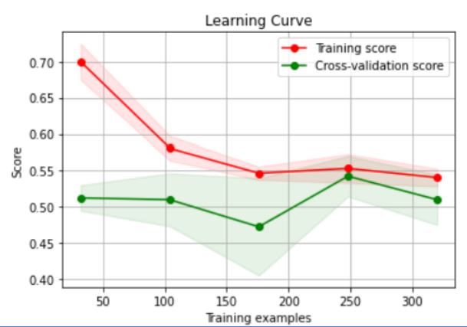
Gaussian Naive Bayes
The concept of independence in classification refers to the idea that the presence of one value of a feature does not influence the presence of another (unlike independence in probability theory).
The evaluated model accuracy for the Gaussian Naive Bayes model is at 52%

